Slide 1
Tacuma Solomon
Machine Learning – Logistic Regression

Slide 2
Introduction
Logistic Regression is a Linear Model
Used to find the probability of a Given Event Happening

Slide 3
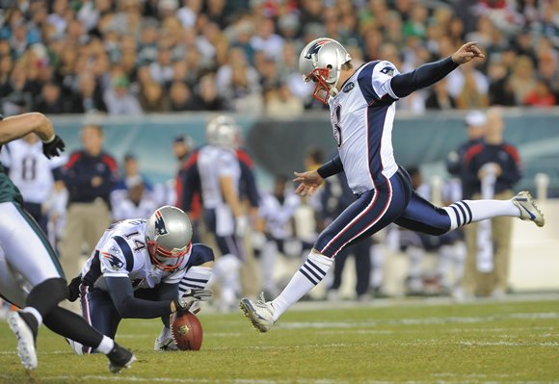
Logistic Regression of NFL Field Goals Attempts(2003)

Slide 4
Logistic Regression of NFL Field Goals Attempts(2003)
http://www.stat.ufl.edu/~winner/datasets.html
Dataset: fieldgoal.dat
Sources: www.jt-sw.com and ESPN.COM
Description: Yardage, Success Indicator, and Week for all NFL Field Goal
attempts in 2003
Variables/Columns
Yards 7-8
Success Indicator 16 /* 1=Good 0=No good */
Week 23-24

Slide 5
Example Sample
32 1 15
32 1 15
28 1 15
50 0 15
37 1 15
23 1 15
35 1 15
49 0 15
43 0 15
46 1 15
42 1 15
27 1 15
50 1 15
26 1 16
38 1 16
37 1 16
46 1 16
29 1 16
46 0 16

Slide 6
Performing Logistical Regression On this Data
Put the values in an ArrayList of Strings
Used a function Called gradient to calculate the gradient
Set t to be 10,000
N to be 0.01

Slide 7
Code (Calculates Gradient)
public static double gradient(double[] w, ArrayList<String[]> dataTable){
double gradientSum = 0;
for (int i = 0; i < dataTable.size() - 100; i++){
double x1 = Double.parseDouble(dataTable.get(i)[0]);
double x2 = Double.parseDouble(dataTable.get(i)[2]);
double y = Double.parseDouble(dataTable.get(i)[1]);
double ynxn = (y * x1) + (y * x2);
double ynwxn = y *((w[0]*x1) + (w[1]*x2));
double singleGradient = ((double)ynxn) /(1 + Math.exp(ynwxn));
gradientSum = (gradientSum + singleGradient);
}
double gradient = - ((double) gradientSum / (dataTable.size() - 100));
return gradient;
}

Slide 8
Logistic Regression (Code)
for (int t =0; t < 10000; t++){
double g = gradient(weights, dataTable); // returns the gradient
double v = -g;
for (int j = 0; j<weights.length; j++)
weights[j] = (weights[j] + 0.001*v);
}

Slide 9
Results
(Using x1, and x2)
Ein = 3.763300332215422E-4
0.3506 weight for x0
0.3506 weight for x1
0.21 on the rest of the data
(Using x1)
Ein = 4.425631491276158E-4
0.4157
0.21

